Slide 1

Luxurious Creation:
Visualize Around Yourself with AR
By
PULKIT KUMAR VERMA, ARADHYA PANDEY AND ANKITA YADAV
(B. Tech 2nd Year, Enrolment No.: 12022002001131, 12022002001044, 12022002001085)
Under the Supervision of
PROF. JYOTI KHANDELWAL
Dept. of Computer Science & Engineering
University of Engineering & Management, Jaipur

Slide 2
Outlines
Introduction
Literature Review
Objectives
Proposed Model
Experimental Setup
Result
Result Analysis
Conclusion & Future Scope
Reference
Acknowledgement

Slide 3
Introduction
The "Luxurious Creation: Visualize Around Yourself with AR" project aims to revolutionize furniture shopping websites by incorporating augmented reality (AR) technology.
Users will be able to visualize how various furniture pieces would look and fit within their own living spaces before making a purchase decision.
The project aims to enhance customer confidence and satisfaction, minimize returns, and revolutionize the way furniture shopping is conducted online.

Slide 4
Literature Review
In [1], The paper introduces the research articles in simplified HTML, which is a web-first format for writing HTML-based scholarly papers.
In [2], This paper presents a tree logic for algorithmic reasoning about CSS selectors, i.e., by developing algorithms for deciding the satisfiability of formulas in the logic
In [3], This paper presents the framework for developing a Mobile Augmented Reality (MAR) and is about the designing of mobile augmented reality (MAR) applications.
In [4], The writer highlights the way of using and taking advantage of 3D models in real life. The 3D models provide almost real-life experience.

Slide 5
Objectives
User-friendly interface: This website encourages the user to buy furniture online by providing a user-friendly environment and a real-time view of their space.
Customization: To Provide the options to buy items of furniture of their desired colour choice.
Personalised App Service: To provide users with a login and registration facility to get the personal cart and a wishlist option for easy product interaction.

Slide 6
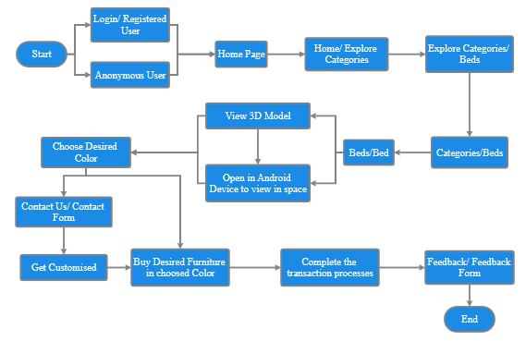
Proposed Model

Slide 7
Experimental Set-up
Software | Hardware
Visual Studio Code Editor | Laptop
HTML/CSS | RAM/ Memory
PHP | Internet
Database | Android Device
Git & Github
Model Viewer Editor
Sketchfab

Slide 8
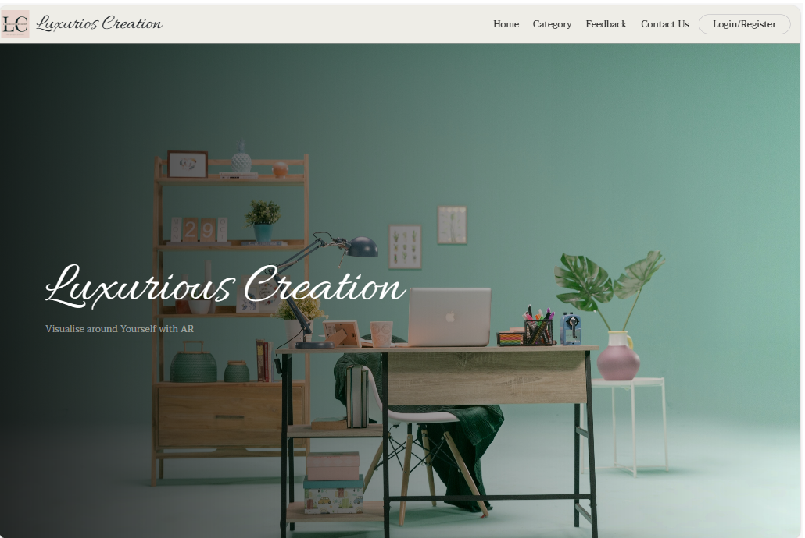
Result
Figure 1: Home Page

Slide 9
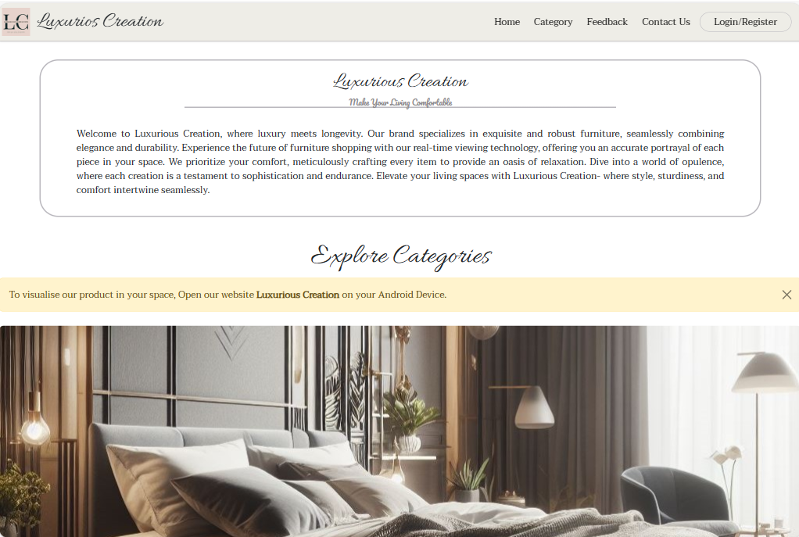
Result
Figure 2: Home Page/Introduction

Slide 10
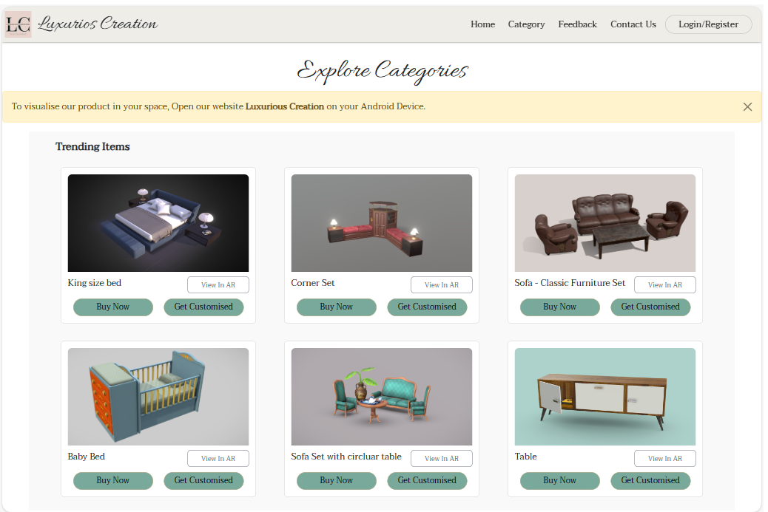
Result
Figure 3: Categories/Trending Section

Slide 11
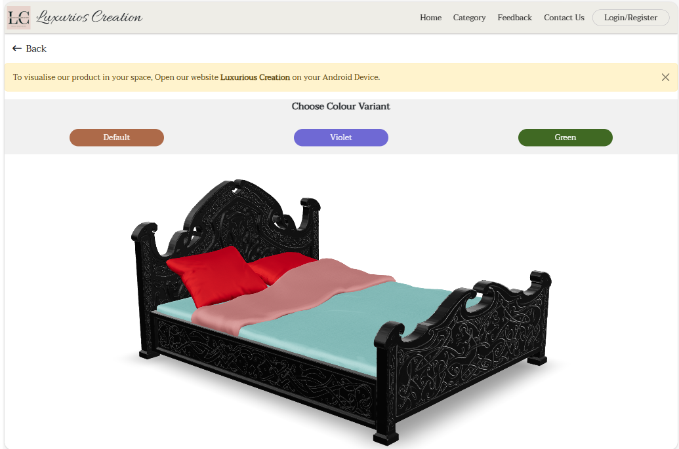
Result
Figure 4: Beds/Bed(Black)

Slide 12
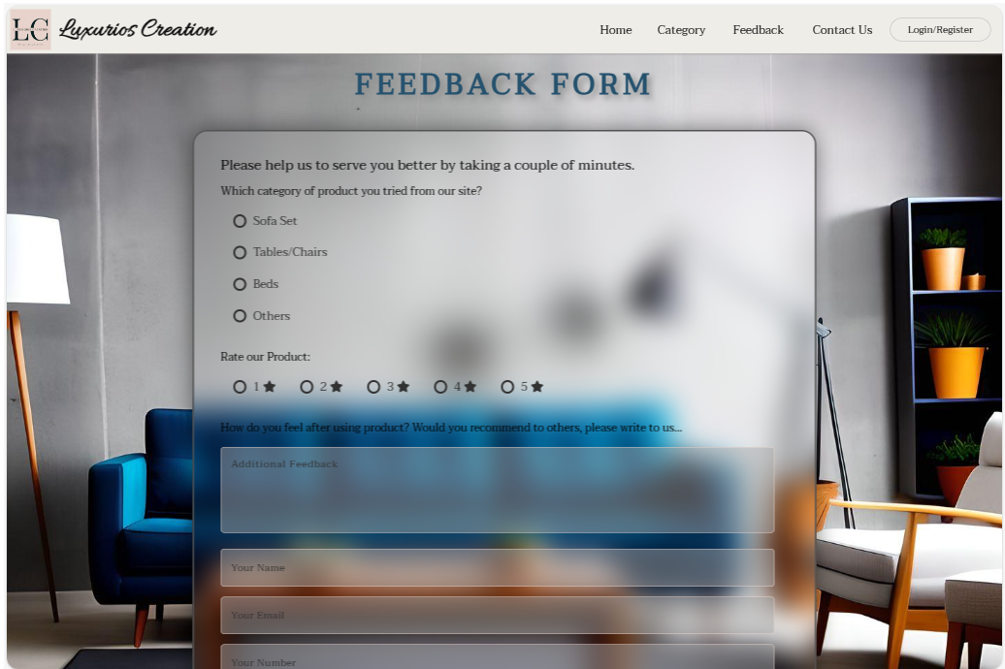
Result
Figure 5: Feedback Page

Slide 13
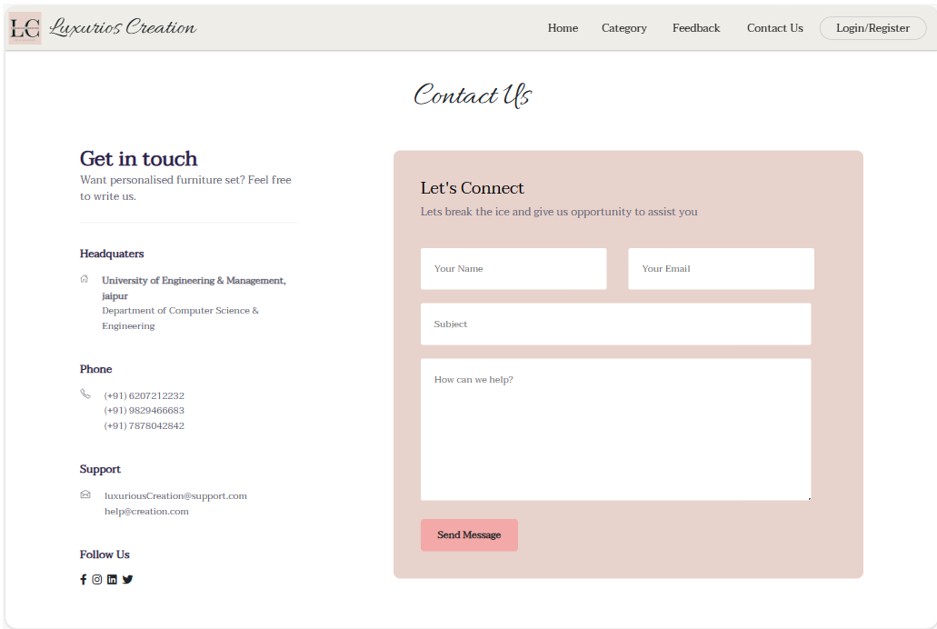
Result
Figure 6: Contact Us Page

Slide 14
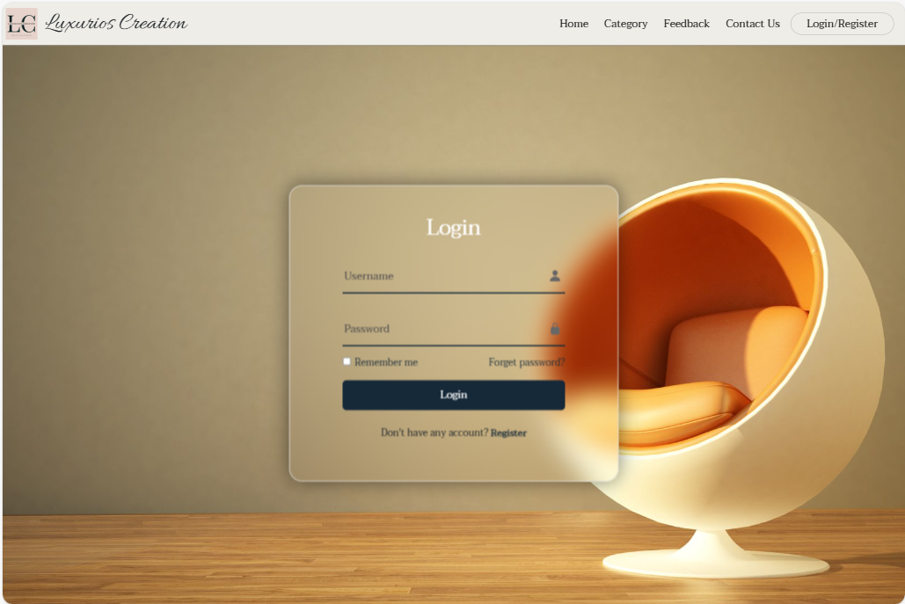
Result
Figure 7: Login/Registration Page

Slide 15
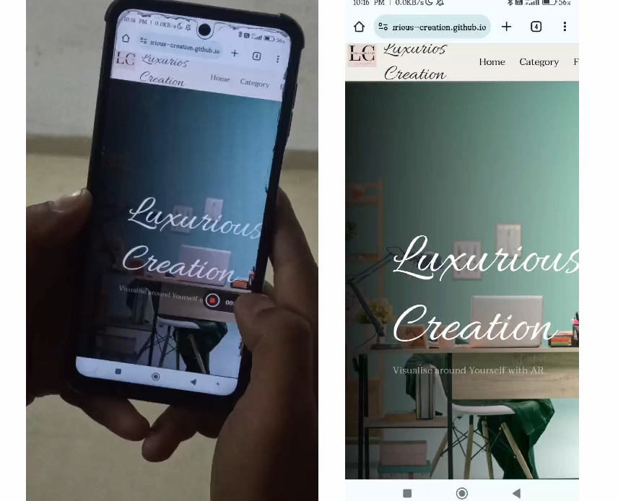
Result

Slide 16
Result Analysis
The website has successfully transformed the online furniture buying experience by prioritizing user satisfaction through a meticulously designed, user-friendly environment.
The challenges of colour selection have been effectively addressed, providing users with tools and features to make accurate choices. The inclusion of customization options allows for a personalized touch, enabling users to create furniture that aligns perfectly with their preferences.
Overall, these collective efforts have resulted in a comprehensive and immersive online furniture shopping experience that goes beyond traditional e-commerce, making the process not only convenient but also enjoyable for users.

Slide 17
Conclusions & Future Scope
Luxurious Creations, the AR-powered furniture website, combines cutting-edge technology with exquisite design, offering users a seamless virtual shopping experience with augmented reality.
Luxurious Creations, the furniture website using cool AR stuff, is set for an awesome future! We're thinking about adding more furniture styles and colours for you to pick from. Imagine customizing your furniture exactly how you want!

Slide 18
References
[1] Peroni, S., Osborne, F., Di Iorio, A., Nuzzolese, A. G., Poggi, F., Vitali, F., &amp; Motta, E. (2017). Research articles in Simplified HTML: A web-first format for HTML-based scholarly articles. PeerJ Computer Science, 3. https://doi.org/10.7717/peerj-cs.132
[2] Genevese, P., Lanadia, N., &amp; Quint, V. (2012, April). on the analysis of Cascading_StyleSheet_Researchgate.https://www.researchgate.net/publication/254008906_On_the_Analysis_of_Cascading_Style_Sheets.
[3] Saidin, N. F., Abd Halim, N. D., & Yahaya, N. (2015). A review of research on augmented reality in education: Advantages and applications. International Education Studies, 8(13). https://doi.org/10.5539/ies.v8n13p1
[4] Paula. (n.d.). Creating 3D content for augmented reality. (2020, May 3). wikitude.https://shorturl.at/oLQX0

Slide 19
Acknowledgement
We extend our heartfelt thanks to our project supervisor Prof. Jyoti Khandelwal, for their guidance and support.
Thanks to UEM, Jaipur for resources. Gratitude to the open-source community for the technologies used.
Lastly, I appreciate my family and friends for their understanding and encouragement.
Special Thanks and Regards to respected senior Souradeep Ash for his continuous support and help.

Slide 20

Dept. of CSE, University of Engineering & Management Jaipur

